Slide 1

Week 3: Mammogram Analysis Project
By JuWon, Neil, Akshaya, Sam, Alex
Peep the epic logo

Slide 2
Methods
Notes:
Sam: First of all, we are going to discuss how we cleaned and augmented our data.

Slide 3
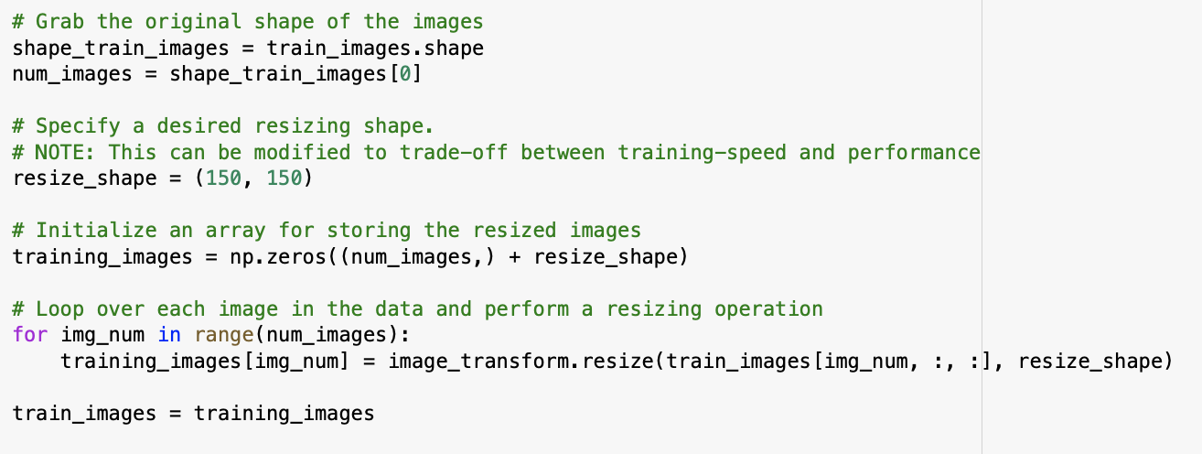
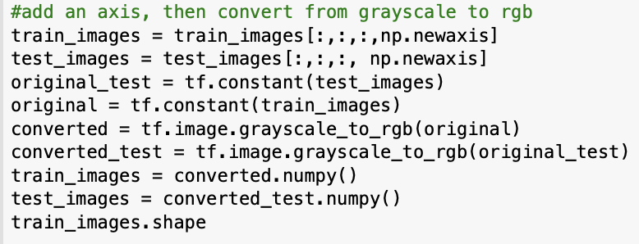

Data Cleaning
Resized images from 300 by 300 to 150 by 150 w/ “transform_image.resize”
Converted Images from Grayscale to RGB w/ “tf.image.greyscale_to_rgb”
Notes:
Sam: We resized our images to be half the resolution in order to save processing time/ power -- larger images would make our notebooks crash bcs not enough RAM.
First, normalized data then,
We also converted images from grayscale to rgb for transfer learning → Inception V3, the model for transfer learning that we used is unable to process grayscale data because it was trained on rgb data originally.
Then we shuffled/partitioned our data

Slide 4
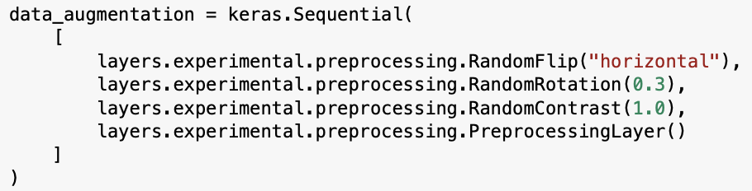
Augmentation
Performed Data Augmentation w/ “layers.experimental.preprocessing”
Notes:
Sam: Since we only had several thousand training examples, we augmented our data by creating random transformations to prevent overfitting and help the model generalize better.
In our intended Transfer Learning model, we used augmentation, but in the end we had to use a CNN model, so we used image smoothening to preprocess the images.

Slide 5
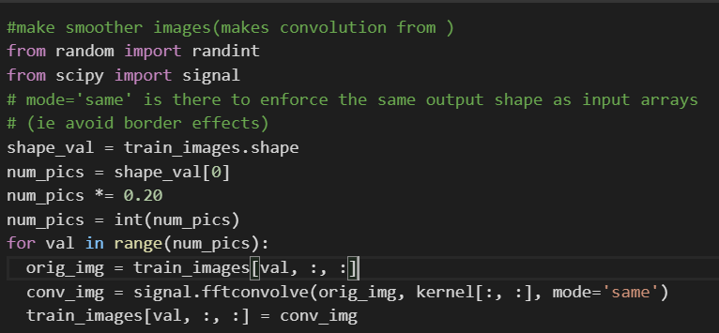
Gaussian
Smoothening
Performed Image Smoothening w/
“signal.fftconvlove”
Notes:
Akshaya: CNN model was overfit to training data. Got the idea from the week’s presentations. Build a Gaussian kernel, and passed image, and the signal.fftconvolve performed the gaussian smoothing by taking the fft of the kernel and image. About 20% were randomly smoothened. We were also working to randomly rotate the image but by then we moved onto transfer learning because we were getting higher roc and acc values. So we implemented rotation in our transfer learning model.

Slide 6
Our Models
Notes:
We experimented with both cnn and transfer learning models.

Slide 7
Intended Final Model for Binary Classification: Inception V3
Model: "sequential_1"
_________________________________________________________________
Layer (type) Output Shape Param #
=================================================================
inception_v3 (Model) (None, 3, 3, 2048) 21802784
_________________________________________________________________
global_average_pooling2d (Gl (None, 2048) 0
_________________________________________________________________
dense (Dense) (None, 32) 65568
_________________________________________________________________
dense_1 (Dense) (None, 2) 66
=================================================================
Total params: 21,868,418
Trainable params: 21,833,986
Non-trainable params: 34,432
_________________________________________________________________
InceptionV3(input_shape=(partial_train_data_tf.shape[1:]),
include_top=False,
weights='imagenet')
Layers. GlobalAveragePooling2D()
layers.Dense(32, activation='relu')
layers.Dense(2, activation='softmax')
Notes:
JuWon: Using our augmented dataset, we experimented with various different architectures with additional dense layers, dropout layers and adding Gaussian noise in order to reduce overfitting before settling with the following architecture for our intended final transfer learning binary classifier. Our final model used 2 dense layers starting with 32 nodes.

Slide 8

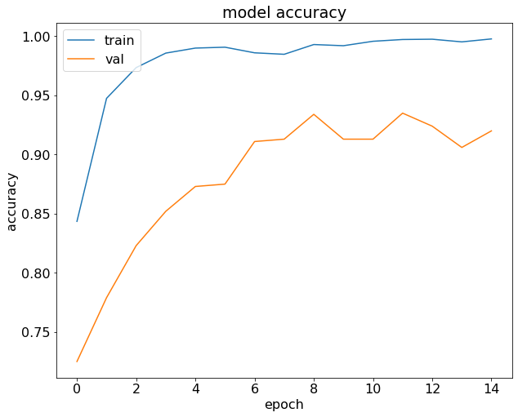
Model Scores (Binary TL)
ROC-AUC Score
Confusion Matrix Score
If only pickling worked….
0.925
789
Notes:
JuWon: As you can see, the validation accuracy caught up slowly to the training accuracy after each epoch. The final confusion matrix score was 789 with a area under the curve of 0.925. However, we ran in to pickling issues with resizing and converting from grayscale to rgb so we submitted our best 2d cnn model.

Slide 9
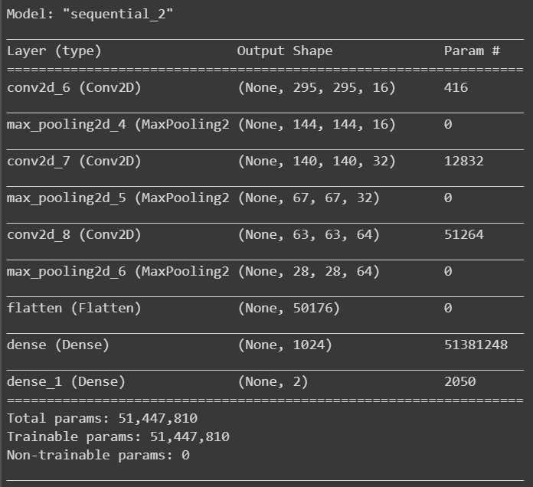
Actual Final Model for Binary Classification: Conv2D NN
3 Conv2D + MaxPooling2D layers, (16->32->64 filters, kernel_size=5,
Pool_size = (8,8)
Layers.
Flatten()
layers.Dense(1024, activation='relu')
layers.Dense(2, activation='softmax')
Notes:
Neil

Slide 10
Parameters (Binary)
Loss Function: Binary Cross Entropy
Learning Rate: lr_schedule (below)
Optimizer: Adam
Batch Size: 50
Epochs: 15
Callbacks: Early stopping( Patience = 7, restore_best_weights = true)
lr_schedule = tf.keras.optimizers.schedules.ExponentialDecay(
initial_learning_rate=1e-4,
decay_steps=10000,
decay_rate=0.9)
Notes:
Neil

Slide 11
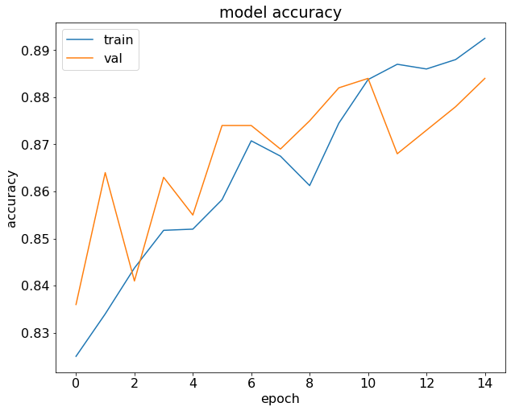
Actual Model Scores (Binary CNN)
ROC-AUC Score
Confusion Matrix Score
0.901
696
Notes:
Neil

Slide 12
Final Model for Multiclass Classification: Inception V3
Model: "sequential_1"
_________________________________________________________________
Layer (type) Output Shape Param #
=================================================================
inception_v3 (Model) (None, 3, 3, 2048) 21802784
_________________________________________________________________
global_average_pooling2d (Gl (None, 2048) 0
_________________________________________________________________
dense (Dense) (None, 32) 65568
_________________________________________________________________
dense_1 (Dense) (None, 5) 165
=================================================================
Total params: 21,868,517
Trainable params: 21,834,085
Non-trainable params: 34,432
InceptionV3(input_shape=(partial_train_data_tf.shape[1:]), include_top=False, weights='imagenet')
Layers. GlobalAveragePooling2D()
layers.Dense(32, activation='relu')
layers.Dense(5, activation='softmax')
Notes:
Alex: Although we were unsuccessful in pickling the Multiclass, our intended model for utilized transfer learning with inception v3 cnn model. It consisted of 4 layers and we did trial and error to determine the number of filters and nodes.

Slide 13
Parameters (Multiclass TL)
# Frozen Layers: 7
Loss Function: Categorical Cross Entropy
Learning Rate:0.00005
Optimizer: Adam
Batch Size: 25
Epoch: 12
Callbacks: Early stopping; Patience = 10
Notes:
Alex: Here are some of the parameters of our model that weren’t covered on the last slide. We also used trial and error to determine many of these values. One thing to note is that we utilized early stopping to help prevent the accuracy from decreasing too much.

Slide 14
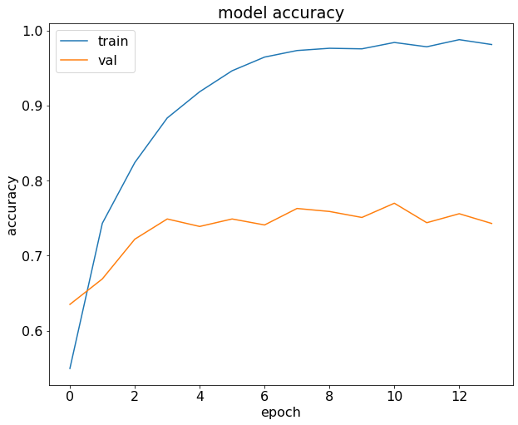
Model Scores (Multiclass TL)
ROC-AUC Score
Confusion Matrix Score
If only pickling worked….
(0.931)
(418)
Notes:
Alex: Here are some of the scores from our Multiclass Transfer Learning model, and as you can see the Confusion matrix score and model accuracy were much lower than the binary model which is as expected. Nevertheless, the area ROC-AUC value was decent at 0.931

Slide 15

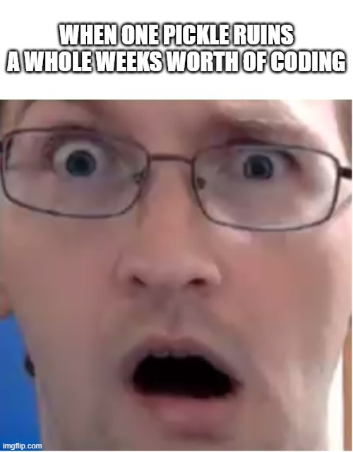
Pickling Problem
What we did to the test images:
Resized the test images and transferred the test images to rgb from grayscale
Long Story Short:
Don’t know what went wrong!
the
Notes:
Akshaya: We ran into resizing issues with our transfer learning model which prevented us from properly pickling it. We eventually could not submit our transfer learning model and opted to submit our alternates. In addition, converting from grayscale to rgb added channels that were not be able to be processed by the pickle program.

Slide 16
Thank you for Listening!
Any Questions?
Notes:
Insert memes here :P

